Slide 1

E-commerce product matching
Paweł Golik
Mateusz Jastrzębiowski
Aleksandra Muszkowska

Slide 2
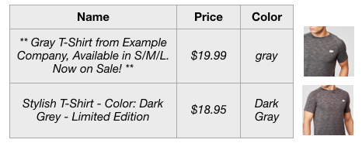
Product matching
The process of matching exact products from different offers based strictly on the product's title, description, and attributes.
Offer 1
The same product
Offer 2
https://techblog.commercetools.com/improving-data-quality-with-product-similarity-search-d037c7212071

Slide 3
Dataset
Web Data Commons – Training Dataset and Gold Standard for Large-Scale Product Matching dataset ( WDC)
Four Categories: Cameras, Computers, Watches, and Shoes
Attributes: title, description, brand, price, etc
Each offer is linked to a specific product (cluster_id).
Each observation is a pair of such offers and a label indicating whether these two offers are for the same product (a positive pair) or not (a negative pair).
The resulting gold standard datasets consist of 150 positive and 400 negative pairs for each category.

Slide 4
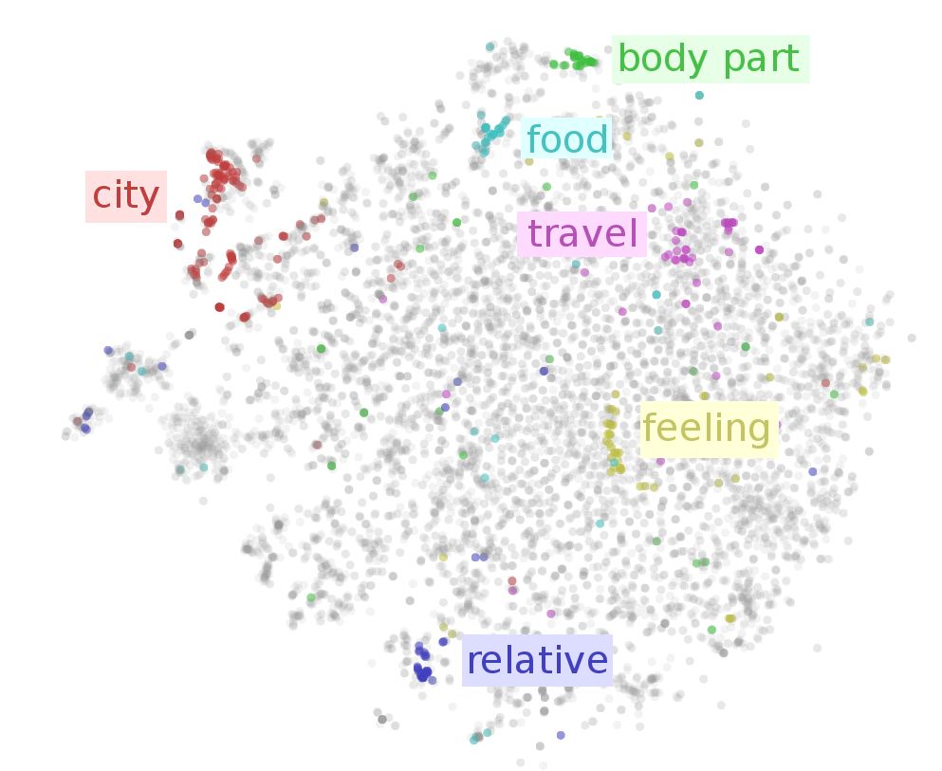
Embeddings
Product 1
The representation of words for text analysis, in the form of a real-valued vector that encodes the meaning of the word.
The words that are closer in the vector space are expected to be similar in meaning.
Product 3
Product 2
Product 4
Product 5
Product 6

Slide 5
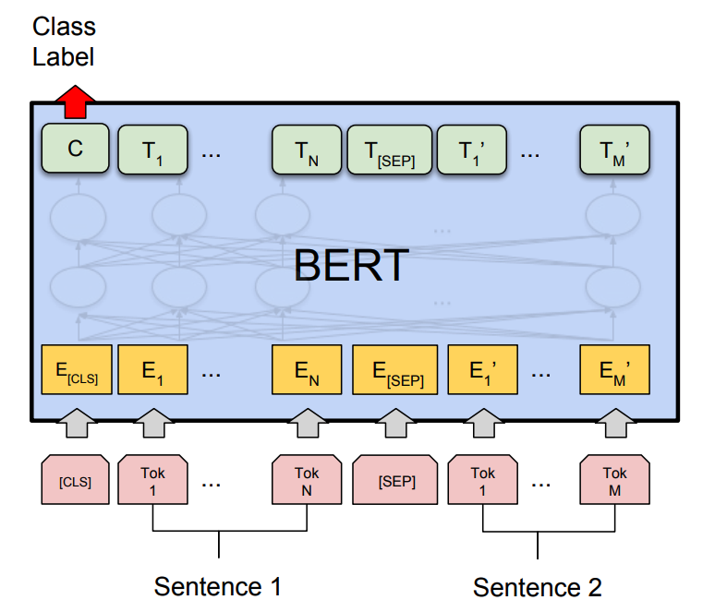
Product Matching Architectures
Pre-trained BERT-based models for the classification task:
mBERT
XLM-RoBERTa
Problems to solve:
Neural Machine Translation
Question Answering
Text summarization

Slide 6
Architectures
Input:
token [CLS] - needed for the classification task
data of the first offer (title, attribute values, descriptions, attribute names, and units),
token [SEP] – separator,
data of the second offer (title, attribute values, descriptions, attribute names, and units)
token [SEP] - marking the end.
Output:
2 classes to distinguish corresponding and non-corresponding pairs of the offer.

Slide 7


Explaining embedding space
Similarity Measures
Probing

Slide 8
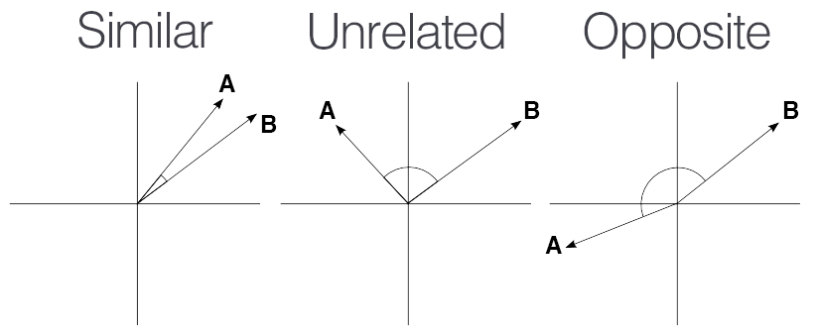
Similarity measures
Examine the similarity of offers
Calculate metrics between extracted embeddings of each offer
e.g. cosine similarity function
https://medium.com/geekculture/cosine-similarity-and-cosine-distance-48eed889a5c4

Slide 9
Probing
Its task is to examine what information is contained in the word embeddings created by the model.
Comparing various state-of-the-art embeddings under the lens of the proposed probing tasks.
Probing semantic embeddings with neural-network based classifiers is like looking into a black box with a lens that is itself a black box.

Slide 10
Probing – How it works?
Take a model trained on some task (product matching).
Generate representations using the model – offers embeddings.
Train another classifier that takes the representations(embeddings) and predicts some properties (probing task).
If the classifier performs well, the model has learned to predict using this property.

Slide 11
Probing tasks
The relationship of the length of the concatenated input to the embedding of the offer.
The impact of keyword content in the offer description
Pseudoword identification
?

Slide 12
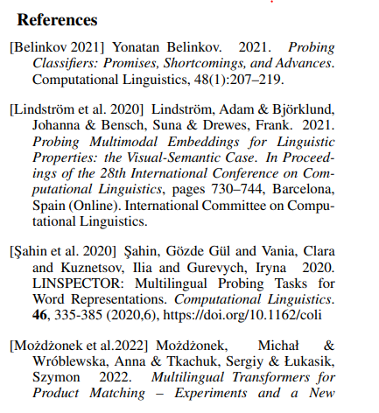
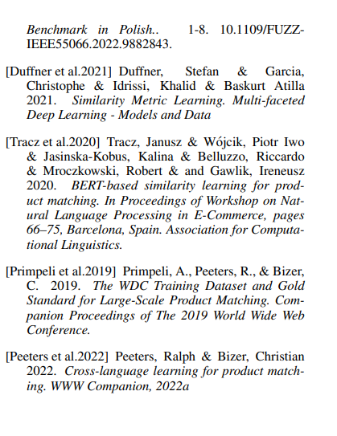

Slide 13
Thank You!

